Slide 1
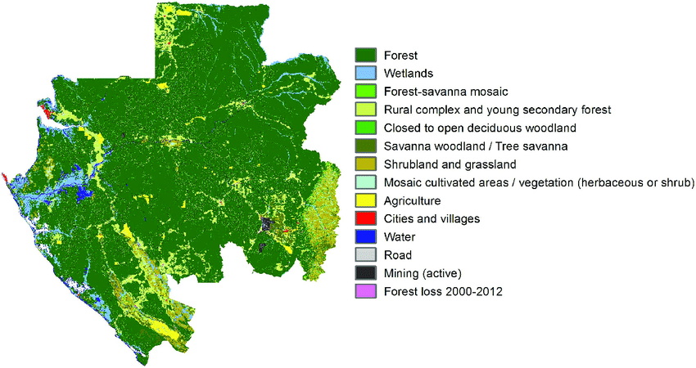
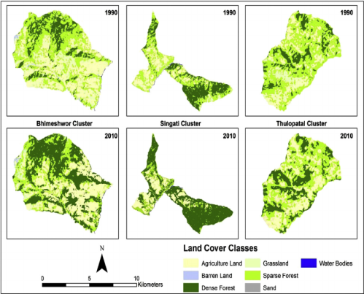
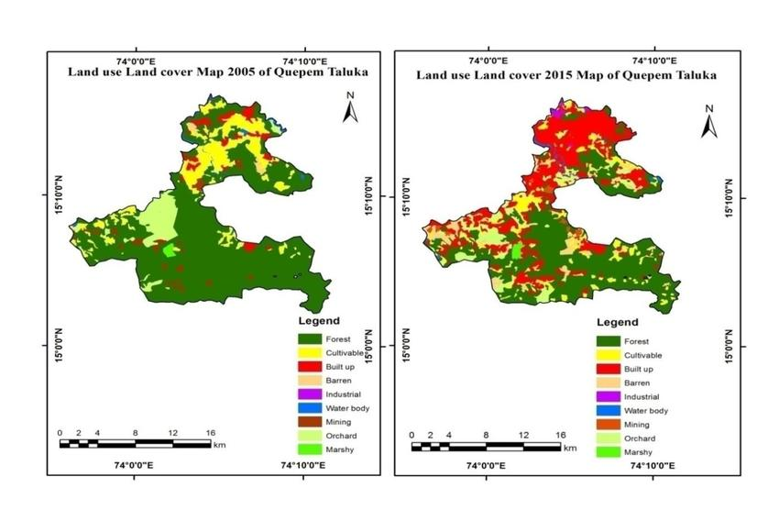
LAND COVER ANALYSIS AND CHANGE DETECTION

Slide 2
INTRODUCTION
Analyze land cover changes in Ghaziabad over the years 2009, 2014, 2019, and 2023.
Focus on residential, agricultural, and barren land.
Predict future land cover changes using linear regression.
Understanding land cover and detecting changes in it are essential for environmental management and decision-making.
In this presentation, we will explore the significance of land cover analysis and change detection.
We will discuss methods, applications, and the role of these processes in shaping our environment.
Let's embark on a journey to comprehend the dynamic nature of our world and the tools we use to monitor it.

Slide 3
PROJECT GOALS AND OBJECTIVES
Goal 1: To introduce the concept of land cover and its significance.
Explain the difference between land cover and land use.
Emphasize the importance of accurate land cover data in environmental studies.
Goal 2: To understand change detection and its role in environmental monitoring.
Define change detection and its importance in tracking alterations in land cover over time.
Highlight the relevance of time-series data for change detection.
Goal 3: To showcase real-world applications of land cover analysis and change detection.
Provide examples of how these processes are used in urban planning, natural resource management, and disaster monitoring.
Demonstrate the impact of these applications on sustainable land use.
Goal 4: To emphasize the ongoing need for monitoring and sustainable land management.
Stress the importance of continually monitoring land cover and changes for informed decision-making.
Encourage responsible land management practices to preserve our environment.

Slide 4
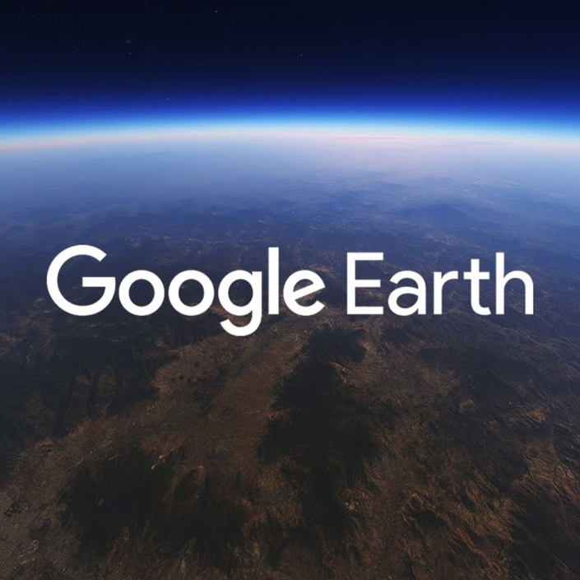


TOOLS AND TECHNOLOGY
GOOGLE EARTH
GLOBAL MAPPER
PYTHON

Slide 5
1. GOOGLE EARTH
Google Earth is a web-based mapping service and software application developed by Google that allows users to explore the Earth and its diverse landscapes, both natural and human-made, through satellite imagery, aerial photography.
Key Features of Google Earth:
Satellite Imagery: Google Earth provides access to high-resolution satellite imagery, offering a bird's-eye view of locations around the world. Users can zoom in to see details at street level.
Street View: Users can access Street View, which offers ground-level panoramic imagery for many locations, allowing for virtual exploration of streets, landmarks, and more.
Historical Imagery: Google Earth includes historical imagery, allowing users to view how a location has changed over time. This feature is particularly useful for change detection analysis.
Measurement Tools: Google Earth provides tools for measuring distances, areas, and elevations, making it valuable for land cover and spatial analysis.

Slide 6
2. GLOBAL MAPPER
Global Mapper is a robust Geographic Information System (GIS) software developed by Blue Marble Geographics. It is a popular tool used for processing and analyzing geospatial data, making it a valuable resource for a wide range of applications, including land cover analysis, topographic mapping, urban planning, environmental management.
Key Features of Global Mapper:
Data Import and Export: Global Mapper supports a wide variety of data formats, including raster and vector data. Users can import data from multiple sources, making it easy to work with diverse datasets.
Data Visualization: Data visualization is the graphical representation of information and data. By using visual elements like maps, data visualization tools provide an accessible way to see and understand trends, outliers, and patterns in data.
Data Analysis and Editing: Users can perform spatial analysis, manipulate data, and edit both raster and vector datasets. The software provides tools for data cleaning and enhancement.
GPS Data Integration: The software supports GPS devices and can import and display GPS tracks and waypoints. It's commonly used for field data collection and mapping.

Slide 7
3. PYTHON
Readable and Maintainable Code: Python’s syntax is clean and easy to understand, which makes it an excellent choice for beginners. Its emphasis on readability reduces the cost of program maintenance.
Dynamic Typing: Python is dynamically typed, which means you don't need to declare the type of a variable explicitly. The type is determined at runtime.
Interpreted Language: Python code is executed line by line, which makes debugging easier and more interactive.
Comprehensive Standard Library: Python comes with a rich standard library that supports many common programming tasks such as file I/O, system calls, and internet protocols.
Extensive Community and Libraries: Python has a large and active community, contributing to a wide range of third-party libraries for various applications, from web development (Django, Flask) to data science (Pandas, NumPy, Scikit-learn).

Slide 8
METHODOLOGY
Data Collection:
Acquire relevant data sources, such as satellite imagery or aerial photos.
Ensure data quality and resolution meet analysis requirements.
Image Classification:
Categorize land cover using classification techniques (e.g., supervised or unsupervised).
Define and assign land cover classes, e.g., forests, urban areas, water bodies.
Change Detection:
Compare multiple images over time to identify changes.
Utilize change detection methods like image differencing or vegetation indices.
Accuracy Assessment:
Validate results using accuracy assessment techniques.
Ground truth or reference data helps confirm the accuracy of classification and change detection.
Visualization and Reporting:
Create maps and visualizations to present the results.
Document and report the methodology, findings, and insights for reference and sharing.

Slide 9
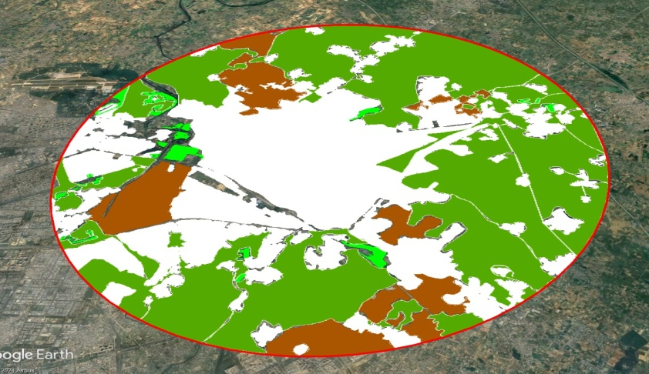
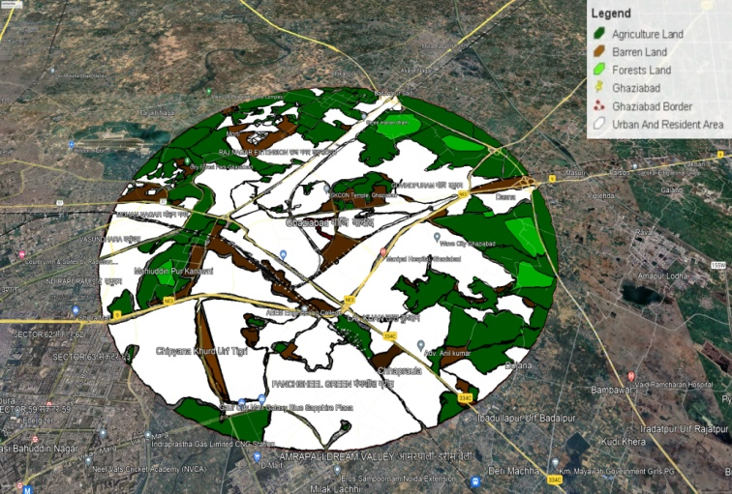
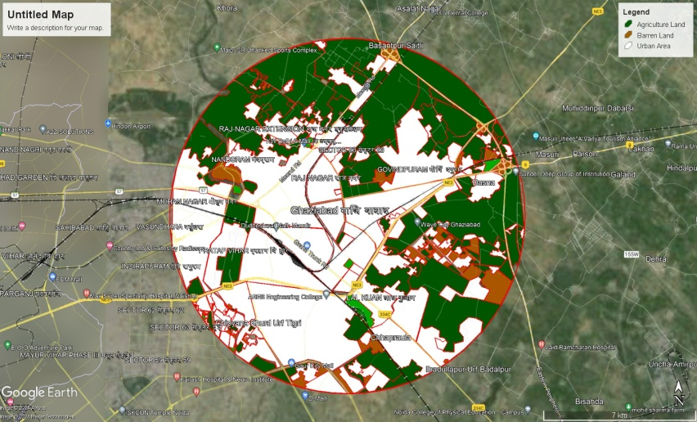
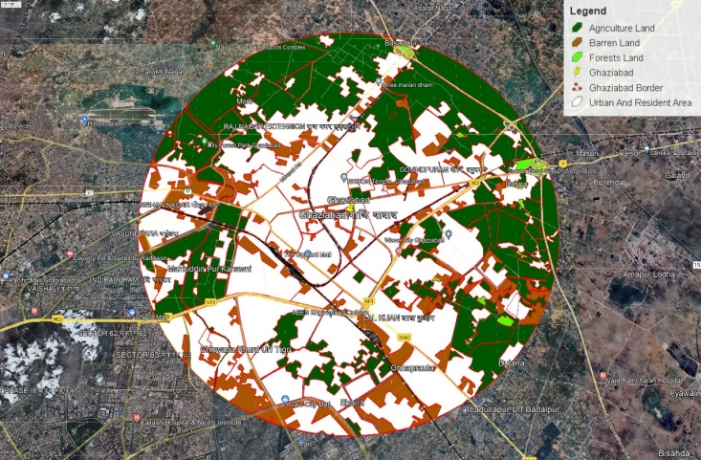
DATA COLLECTION
2009
2014
2019
2023

Slide 10
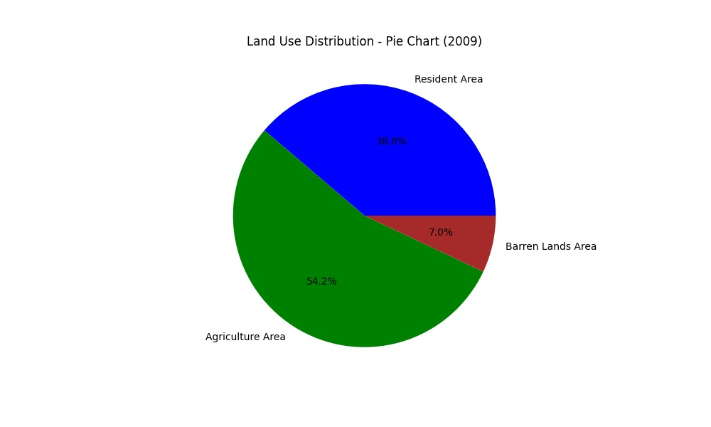
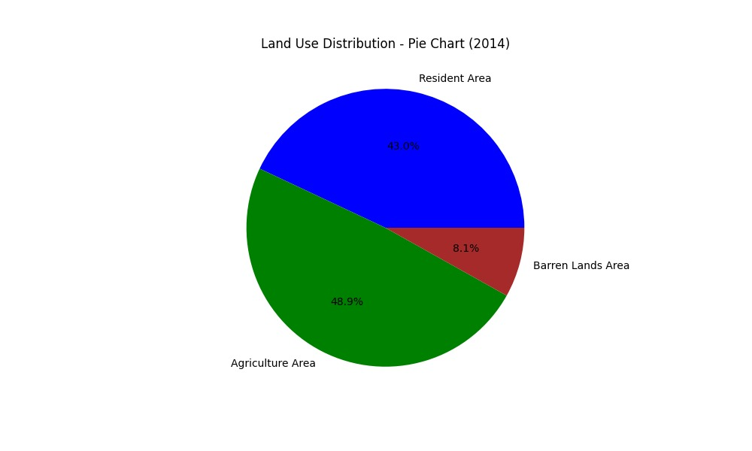

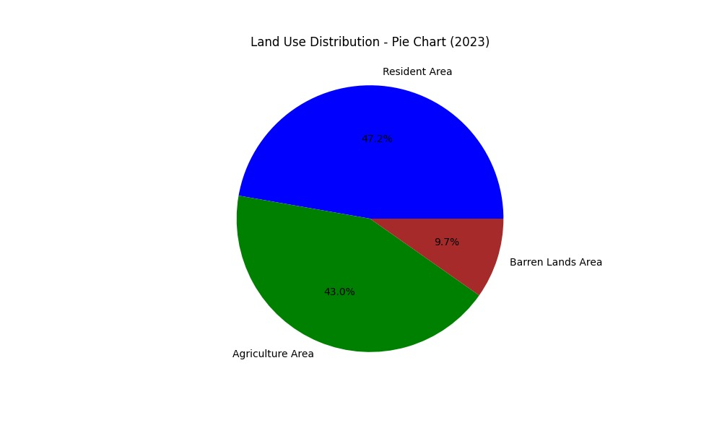
CHANGE DETECTION BY PIE CHART
2009
2014
2019
2023

Slide 11
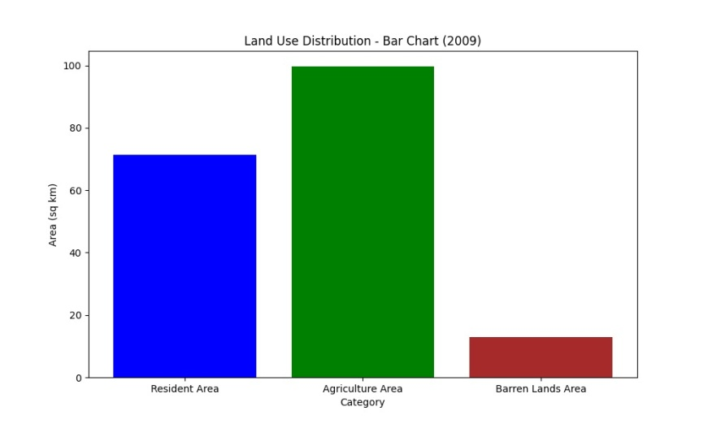
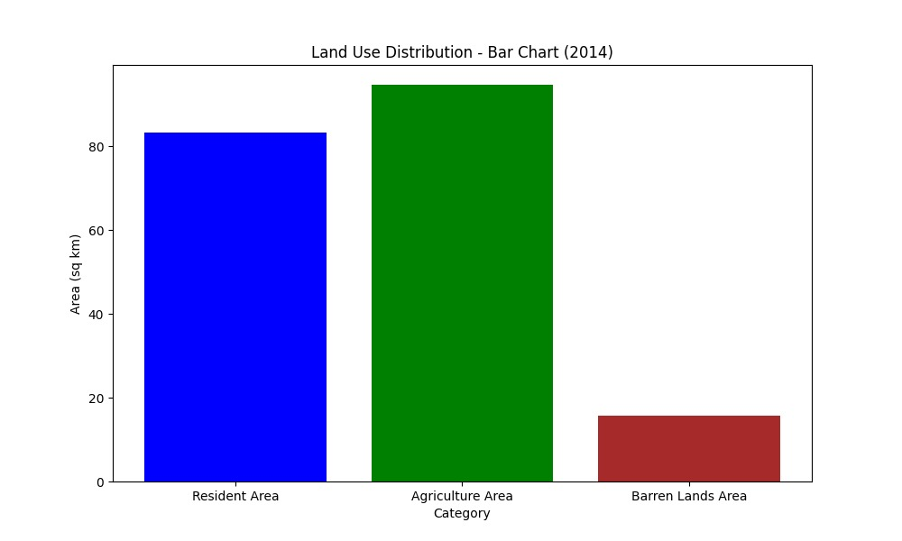
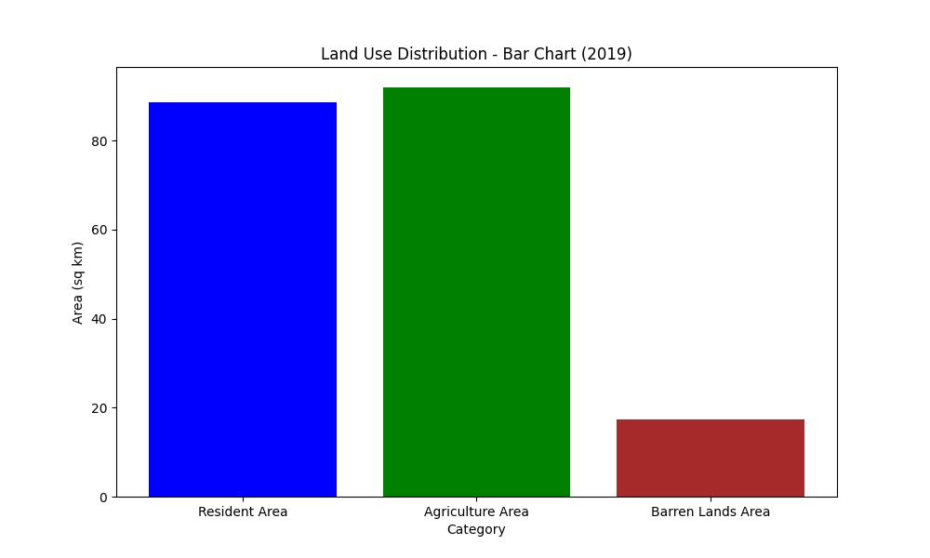
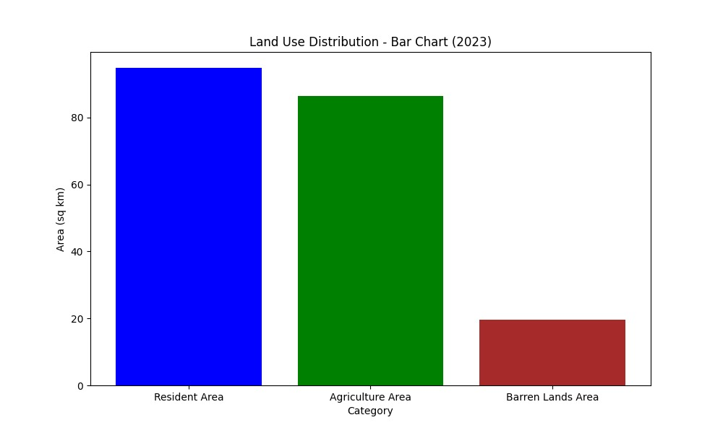
CHANGE DETECTION BAR CHART
2009
2014
2019
2023

Slide 12
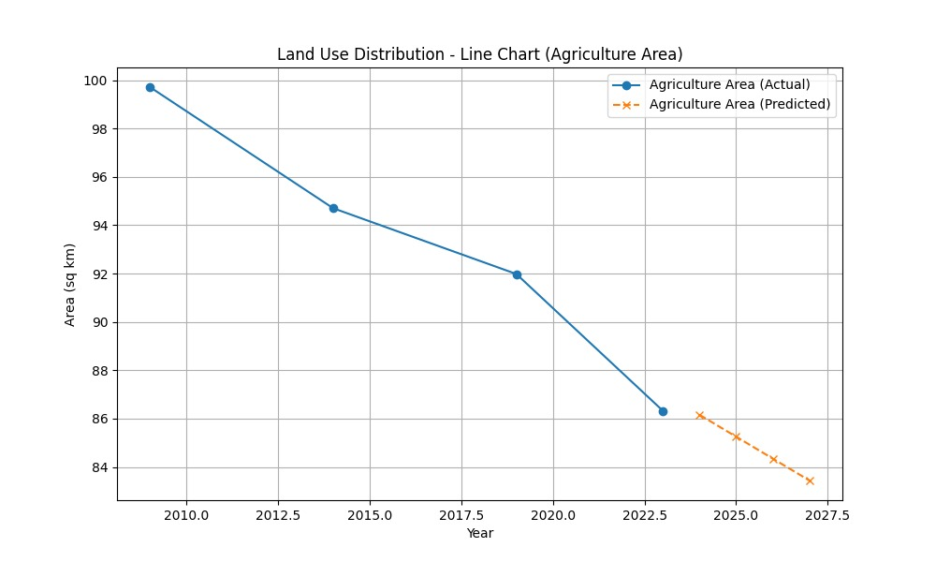
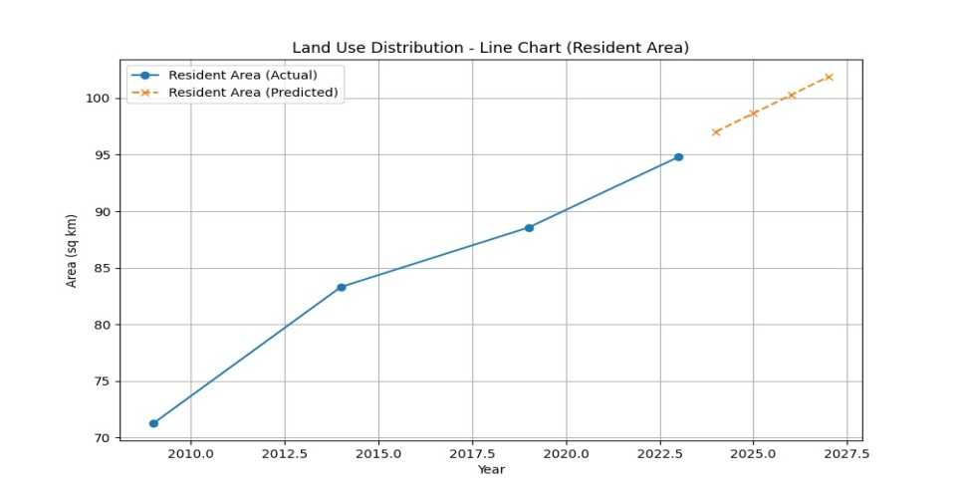
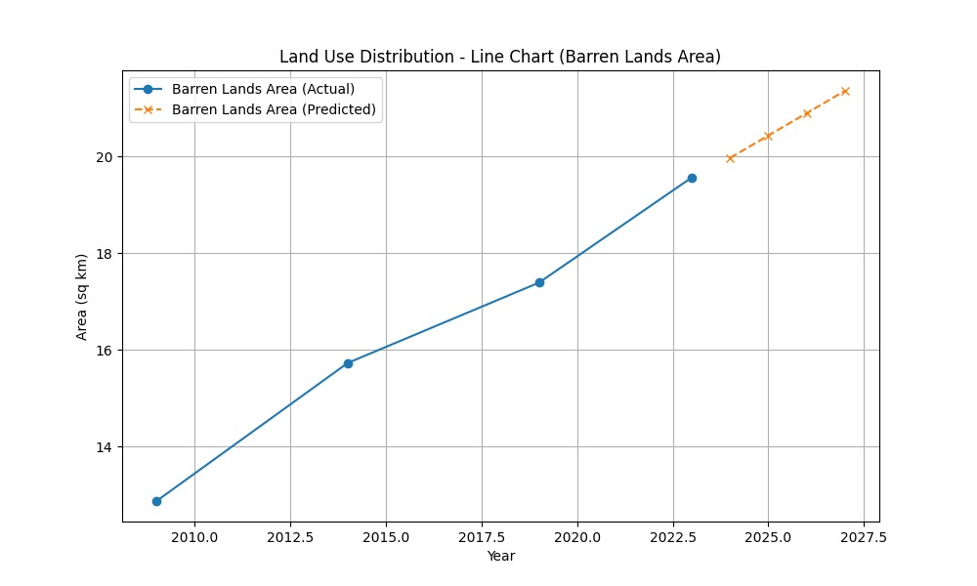
Linear Regression Predictions

Slide 13
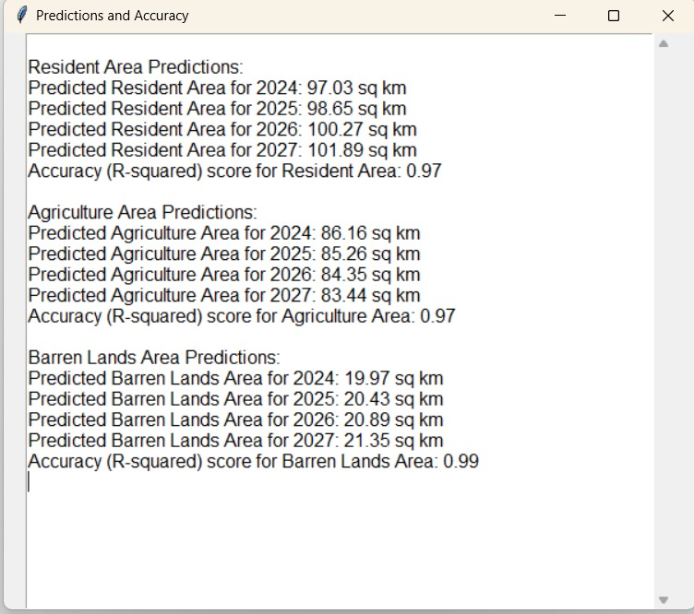
OVERALL PREDICTION

Slide 14
RESULT
Land Cover Analysis Findings:
Summarize the key findings of the land cover analysis.
Highlight the distribution of land cover types and their changes over time.
Change Detection Results:
Present the results of change detection, including the areas and types of changes detected.
Use visual aids, such as maps or graphs, to illustrate significant findings.
Significance of the Findings:
Discuss the importance of the results in understanding our environment.
Explain how land cover analysis and change detection contribute to informed decision-making.
Applications and Implications:
Describe the practical applications of these findings, such as in urban planning, conservation, or disaster management.
Highlight the implications for sustainable land use and environmental conservation.
Challenges and Future Directions:
Acknowledge any challenges faced during the analysis.
Suggest potential future directions, like improving data quality, expanding the study area, or integrating new technologies.

Slide 15
TEAM MEMBER
Anushka Tiwari (2001430130014)
Ayushi Goel (2001430130020)
Barun Kumar Mishra (2001430130021)
Harshit Chauhan (2001430130032)
PROJECT GUIDE
Dr. S.N Rajan
Project Supervisor
Professor
Information Technology
IMSEC , Ghaziabad

Slide 16
THANK YOU

